Slide 1


Senior Design Project
Final Year Project Management System
Supervised By: : Zeeshan Sabir (Teaching Fellow)

Slide 2
Project Team
Muhammad Muneeb(7757)
Umair Qamar(10776)
Bilal Hassan(7471)

Slide 3
Table of Content
Introduction / Background
Existing Systems
Problem Statement
System
Requirements Summary
Design Summary
Implementation Summary
Testing & Evaluation Summary
Conclusion and Outlook

Slide 4
Introduction / Background

Slide 5
Introduction / Background
Final Year Project Management System is web-based solution designed for Riphah International University
Manages current and previous final year projects.
All activities/processes involved in final year projects

Slide 6
Existing Systems

Slide 7
Existing System
There are existing systems designed for different universities in Pakistan
In Riphah International University there is no such system to manage projects
In Riphah International University we use Moellim VLE to handle Final Year Projects

Slide 8
Existing System
All activities and process are handled manually.
There is no repository of previous Final Year Projects
Moellim VLE is not customized to manage final year projects processes/activities

Slide 9
Problem Statement

Slide 10
Problem Statement
Students don’t have any idea of previous projects ideas, status and information
No platform containing Final Year Project archive/repository.

Slide 11
Problem Statement
Many of the projects fail because of barriers of communication between supervisor and students.
Students mostly face the problem of meeting the supervisor, Managing time to meet supervisor.

Slide 12
Solution

Slide 13
Solution
A customized solution should be there to handle all the Final Year Projects lifecycle
A system should be there to
Manage all final years projects lifecycle
Maintain previous projects repository
Should be available online

Slide 14
SYSTEM

Slide 15
Requirements Summary
Elicitation Techniques / Tools
Market/Literature Survey
Wire Framing / Prototyping
Specification / Documentation
SRS

Slide 16
Requirements Summary
List of Different Users
Student
Supervisor
Coordinator
Faculty, or External Examiner.
Functional & Non Functional Requirements

Slide 17
Functional Requirements
Project Repository
Initiate a group or Join an existing group
Choosing Supervisor
Timeline
Batch Tasks
Meeting Logs

Slide 18
Send Emails
PDF Reports (Student Report, Group Report, Batch Report)
Student Grading
Internal Demo Evaluation

Slide 19
Non-functional Requirements
Stability
Understandability
Operability
Availability
Usability
Modifiability
Consistency
Security

Slide 20
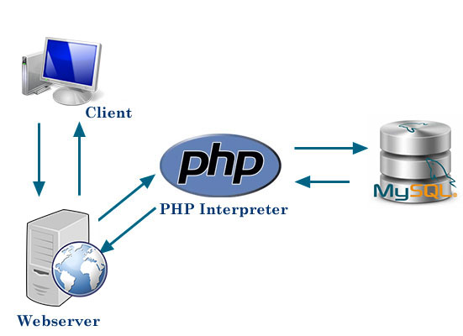
Design
Notes:
Design:
Include a deployment diagram that provides overview of the entire system (hardware / software components)

Slide 21
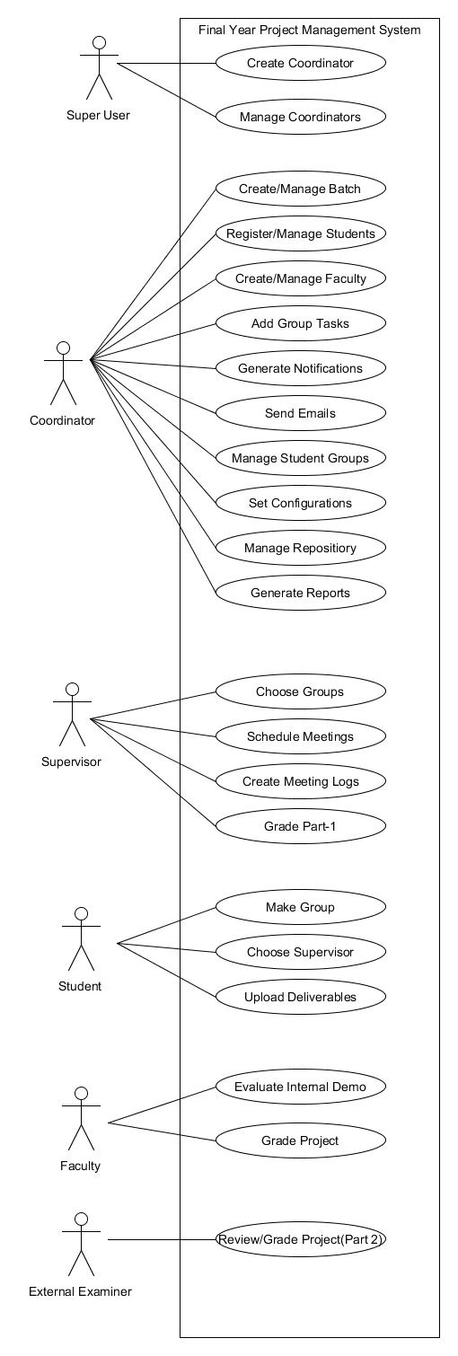
Use Cases

Slide 22
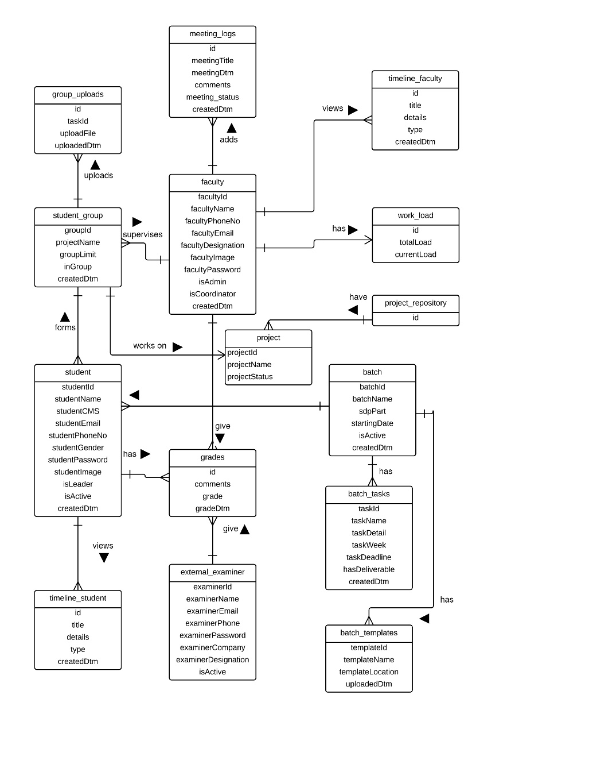
ERD Diagram

Slide 23
Implementation
Development Tools & Technologies
Best Practices / Coding Standards
Libraries / Components / Web Services
Notes:
Implementation:
List down various development tools & technologies you are using in your project
Point out if you are using any coding standards / best practices
List down various libraries / components / web services that you have identified / decided to use in your project

Slide 24
Development Tools & Technologies
PHP: For server side scripting language
MySQL: as Database
JavaScript: client side scripting
JQuery, Ajax: for easy form validations and other functionalities
Bootstrap, media queries :for responsive, mobile-first web site

Slide 25
Best Practices / Coding Standards
Mobile Friendly Responsive Design
W3 Validation
Attributes and Tags in lower case
Proper Indentation
Externalized CSS
JavaScript at Footer

Slide 26
Libraries / Components / Web Services
Sendgrid API
Kendo UI PDF
Bootstrap Validator
Bootstrap Datetime picker
wysihtml5
Bootstrap Components
Fonts Awesome, Ionicons
Admin LTE Theme

Slide 27
Testing & Evaluation Summary
Blackbox tesing
Input: password
Valid:
Email = ’saudkhan@riu.edu.pk‘
Invalid:
Email= ‘saudkhan’
Email = ‘ ’

Slide 28
Test Case # | 1 | 2 | 3
Email |  | Saudkhan | saudkhan@riu.edu.pk
P. Tested | Email = ‘ ’ | Email= ‘saudkhan’ | Email = ’saudkhan@riu.edu.pk‘
Exp Output | Error | Error | OK

Slide 29
Conclusion and Outlook

Slide 30
Final Year Project Management system automates the Final year Projects lifecycle
This solution is made for Riphah International University

